Slide 1
Sixth Form Year 12 Expectations Evening

Slide 2
PTFA Welcome your help and support
In you would like more information on how you can support or get involved:
pta@plymouthhighschoolforgirls.org.uk

Slide 3






Mr Underdown

Slide 4
Making the most of every learning opportunity and working hard to achieve

Slide 5
The Purpose of data
Yr12 term 1 check in
Yr12 mocks April/May 2027
Yr13 mock 1 Nov 2027
Yr13 mock 2 Jan – Mar 2028
Predicted grades objective – supported by data
12
Final exams summer
2028

Slide 6
Preparing for the next step after A levels (already!)

Slide 7
Tutorial sessions
Compulsory – Year 12 and 13
Helping you to progress to a successful Sixth Form
Independent study skill sessions
Information about topics outside of the academic stream
Support for deciding on post A level options
Leadership opportunities
charlie.doddrell@phsg.tsat.uk

Slide 8
Preparing for the next step Dr Doddrell
2026 destinations
88.9% going on to university now or following a gap year
36% of university places secured are at Russell Group institutions
100% on to study Medicine, Dentistry or Veterinary Medicine
Students without a goal or vision hit a ceiling and underperform by about one grade. Students who don’t know why they’re doing A levels, are usually the first to show decreased levels of effort when the going gets tough. Oakes and Griffin 2016
Notes:
Overwhelmingly, most of our students opt for uni – process is supported by Ms Findlay - some choose apprenticeships and a small number employment - encouraged to be aspirational in their choices – successes with Oxbridge and Med – but all pathways valid and personalised approach to supporting find a next step that's suitable for a successful future.
Other uni courses: 10 Law. Others include Architecture, Physics, Economics, Agriculture, Korean, Anthropology, International Relations...- showing how personalised our support is

Slide 9
What support looks like here and at home
Experienced tutorial team delivering programme of information
One-to-one guidance
Careers Adviser appointments
Visit to Russell Group university
Finance talk
Unifrog resource platform
Mock interviews
UCAS convention
Apprenticeship fair
Workshops at University of Plymouth
Visits form alumni and professionals
Notes:
Wealth of experience in dedicated team of tutors – offer a range of experiences and personalised guidance to help students decide the path for them and guide them through the application process.

Slide 10
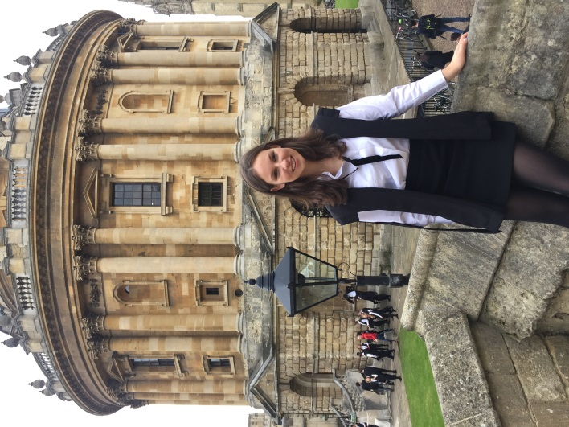
Oxford and Cambridge
Early application date: 13th October
Workshops delivered by the Universities of Oxford and Cambridge
Free accommodation for visiting open days at Oxford
Bespoke advice about suitable super-curricular activities
Regular one-to-one meetings
Interview practice
Tailored school reference
Recent successes include:
Veterinary Medicine at Cambridge
Law at Oxford and Cambridge
Theology at Oxford
Philosophy, Politics and Economics at Oxford
Earth Sciences at Oxford
Notes:
The path for Oxbridge is different so Ms Findlay works closely with those identified as potential applicants to offer guidance e.g. interview practice.

Slide 11

Doctors, Dentists and Vets
Application:
Only school in the city with bespoke and timetabled support lessons
100% of medical applicants gain offers
100% of veterinary applicants gain offers
100% dental applicants gain offers
Year 13 finished: 3 Medicine, 1 Vet and 1 Dentist.
Year 12 lesson Wed A p1 or Tuesday B p3

Slide 12
Mr Jenkins - The Why!
Doing all we can to best ensure that every PHS sixth form student achieves what they require for their best post-18 next steps
A level results day 10th August 2028, 701 days away
Approximately 612 days until the first A level exam

Slide 13
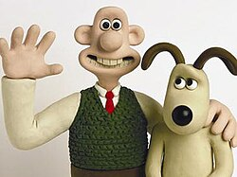
The aim for results day
All students progress onto their best post 18 next step

Slide 14
The PHS Sixth Form Team
Alan Jenkins
Assistant Head Teacher / Head of Sixth Form / DDSL
Recruitment • Induction • Year 12 progress to mocks • Student Leadership
Charlie Doddrell
Deputy Head of Sixth Form
Post-Year 12 mocks to Year 13 • UCAS/Oxbridge • Medical pathways
YEAR 13 TUTOR TEAM
• Adrian Waite
• Ed Baines
• Leon Graves
• Cate Taylor
Karen Mills
Sixth Form Lead Administrator / Assistant to the Head of Sixth / DDSL
Administration • Sixth Form pastoral team • TLP logistics • Bursary
Jen Catchpole
Sixth Form Attendance & Study Centre Coordinator
Attendance • Study Centre and 10th Hour coordinator • Sixth Form pastoral team • KS5 trips
YEAR 12 TUTOR TEAM
• Siobhan Blunden-Currie
• Vicky Carter
• Richard Mallard
• Kate Tomalin
• Tom Varrall

Slide 15
A simple expectation
That students treat their Sixth Form studies and their own Studentship as a full-time profession. It needs to be their number 1 priority if they are to successfully achieve their best next step and keep on top of their mental health.

Slide 16
Our SFSC and the 5 50 5
5 50 5 – so every student can rely upon a quiet space to complete their independent study

Slide 17
Yr12 Economics
We have had 3 lessons so far
One assignment set during lesson 1 on Monday for today
Expectations:
Students to review their notes after the lesson to reinforce understanding – some may create flash cards or convert the notes into a digital form….set a timeline to review again….and again
Using their non-contact study time, they will have completed the set task for the lesson – if they have any questions, they will ask the teachers failing that inform Mrs Catchpole so that support can be found.
Folder check – Behaviour for learning – Small assessment during this term

Slide 18
What to wear?
Students must take pride and consider their appearance. They are expected to dress in a manner that is smart-casual, comfortable yet purposeful, and suitable for a school working day.
(For experiments in science they require full length trousers and closed toe shoes)

Slide 19
Attendance Year 12
We expect students in school for all of their lessons to complete independent study up to the year 12 mocks.
Once they have successfully graduated, they will have the choice after break if free to leave the site for study
They are to sign in and out at the main reception when they want to leave during break and lunch

Slide 20
Five established KS5 leadership roles
HOUSE CAPTAINCY
Build belonging and participation
SUBJECT AMBASSADORS
Champion your subjects
EARTH ALLIANCE
Lead environmental action
SIXTH FORM PREFECTS
Model Sixth Form standards – represent the study body
HEAD STUDENT TEAM
Represent and influence across the school and trust

Slide 21
Student Leadership
Our Sixth Form Prefect Leads
Zoe – Head Prefect
Beauty – Deputy Head Prefect

Slide 22
Registration activities – Leadership Opportunity
Monday
Assembly
Tuesday
Current Affairs & Unpicking Paintings
Wednesday
A) Reading for pleasure (silent)
B) Academic reading to support study skills
Thursday
Careers and Next Steps – Tutorial Preparation
Friday
House events/Quiz
If you would like to be part of the Registration Leadership Group (RLG), a chance to work with Sixth Form Team to create engaging activities to support our Sixth Form community please look out for an email this week
Everyone leads
Caroline Robinson – BBC Journalism apprenticeship

Slide 23
Enrichment
PE/Games sessions
Exeter University
Plymouth University
Cardiff, Bristol or Birmingham
UCAS and Apprenticeship Fair
Learn to Live
Italy
Wellbeing events
First Aid course
TEFL
Prom

Slide 24
Plymouth High Sixth Form maximising post-18 opportunities
We all have the same goal, we are all facing the same way!

