Slide 1
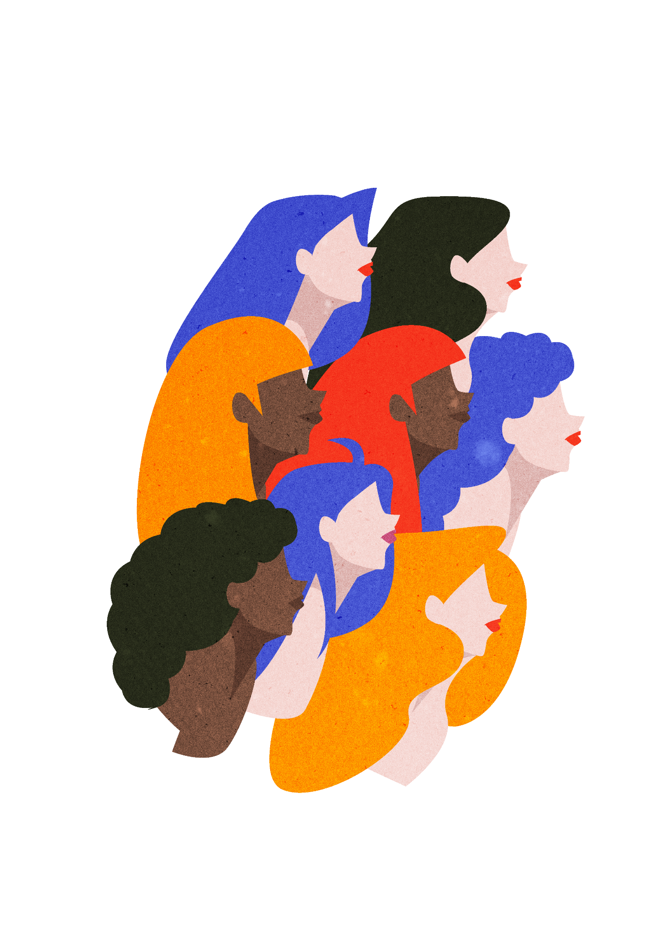
International Women's Day 8th March

Slide 2
Influential Women who have changed the World!

Slide 3
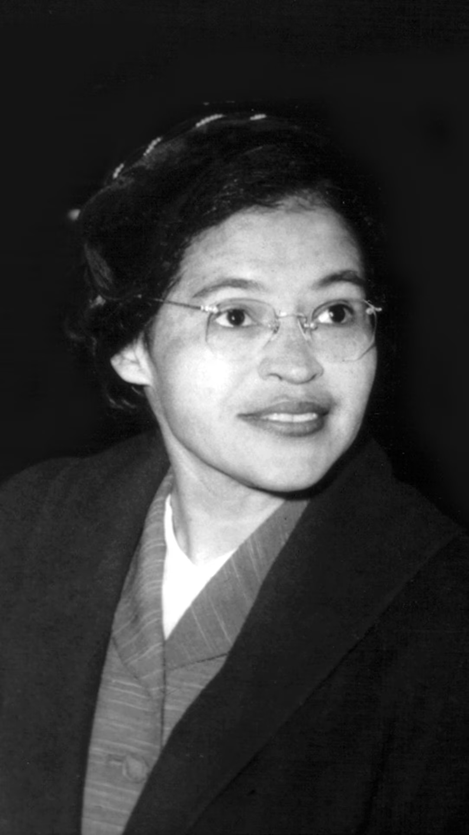
Rosa Parks
Her refusal to give up her seat sparked the Montgomery Bus Boycott.
Became a global symbol of the civil rights movement.

Slide 4
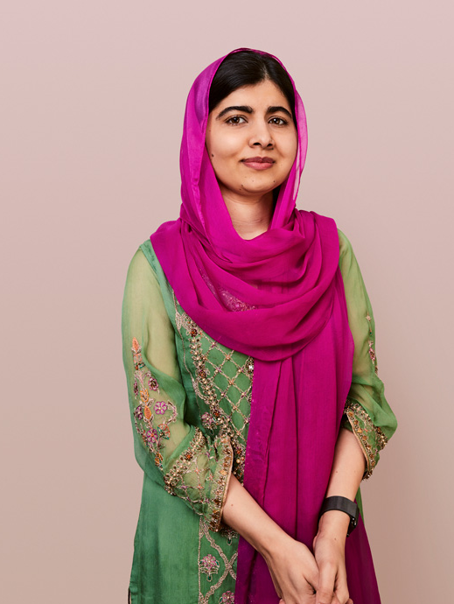
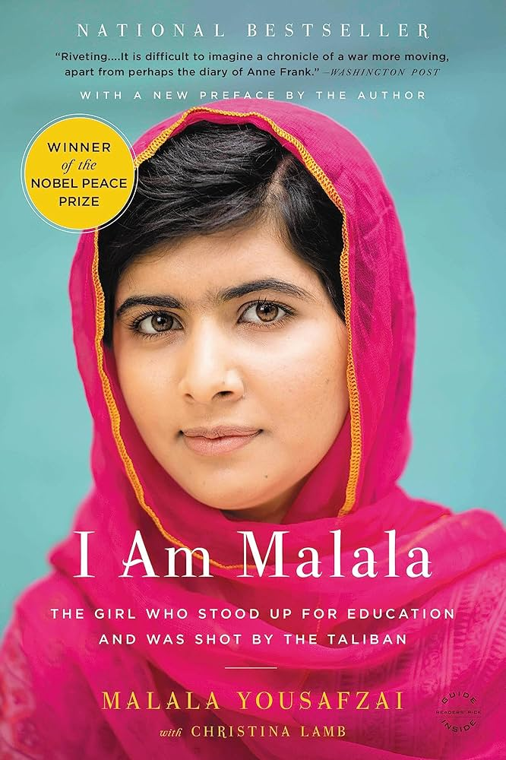
Malala Yousafzai
Born in Swat, Pakistan, where she observed and spoke out against the banning of women's education
Activist for women's education
Survived an assassination attempt by the Taliban at age 14
Youngest Nobel Peace Prize Laureate

Slide 5
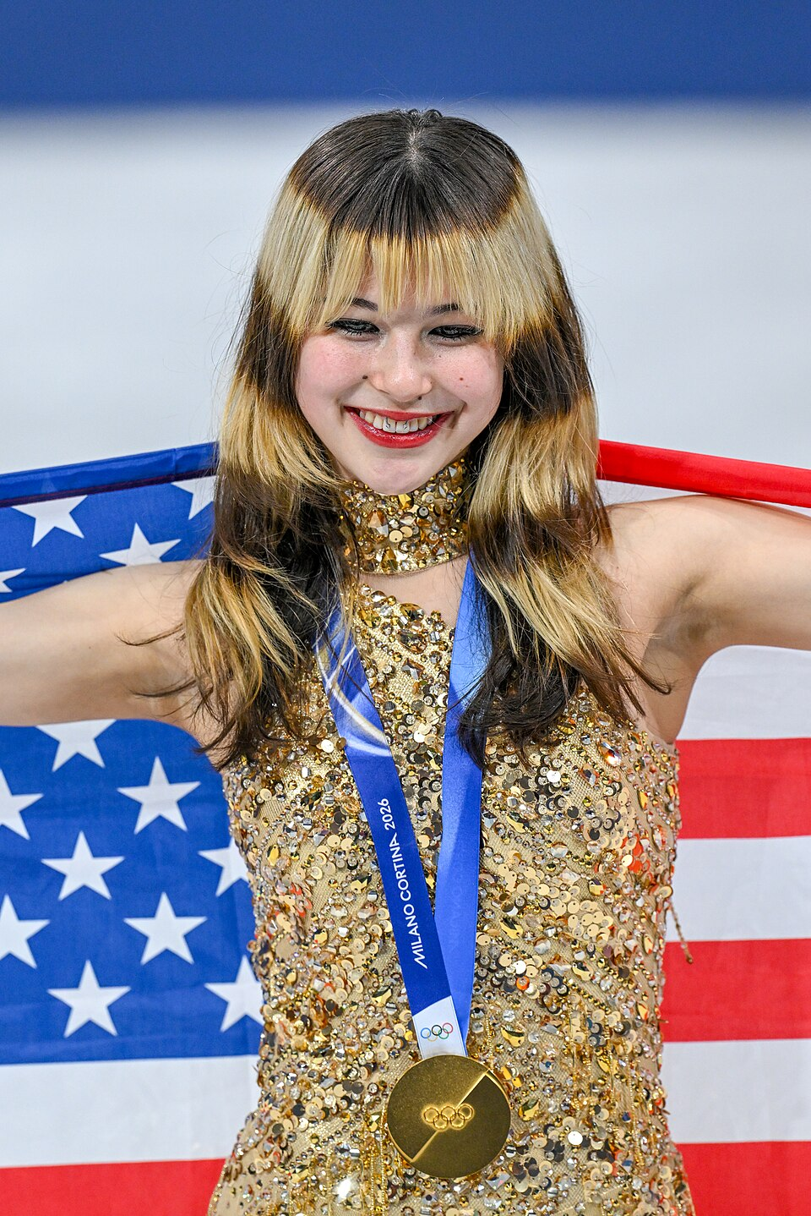
Alysa Liu
First American woman to win an individual Olympic figure skating gold medal
The youngest skater in history to land a triple axel in an international competition at the age of 12
Her success inspires girls around the world to try sports and believe in their abilities.

Slide 6
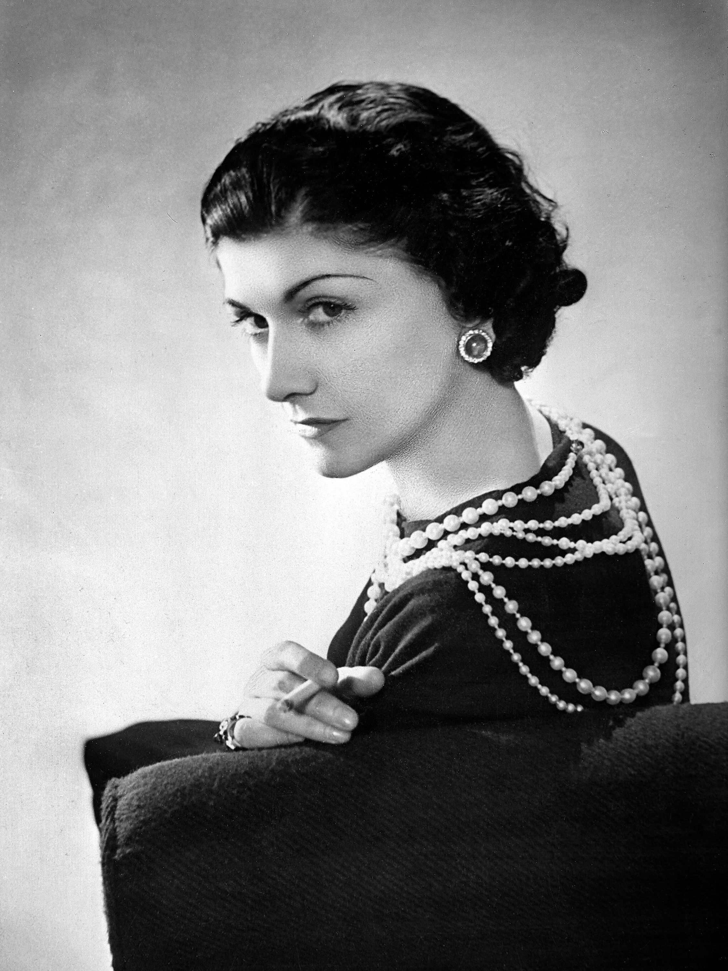
Coco Chanel
Revolutionised women's fashion, pushing for the development of comfortable and non- restrictive clothing

Slide 7
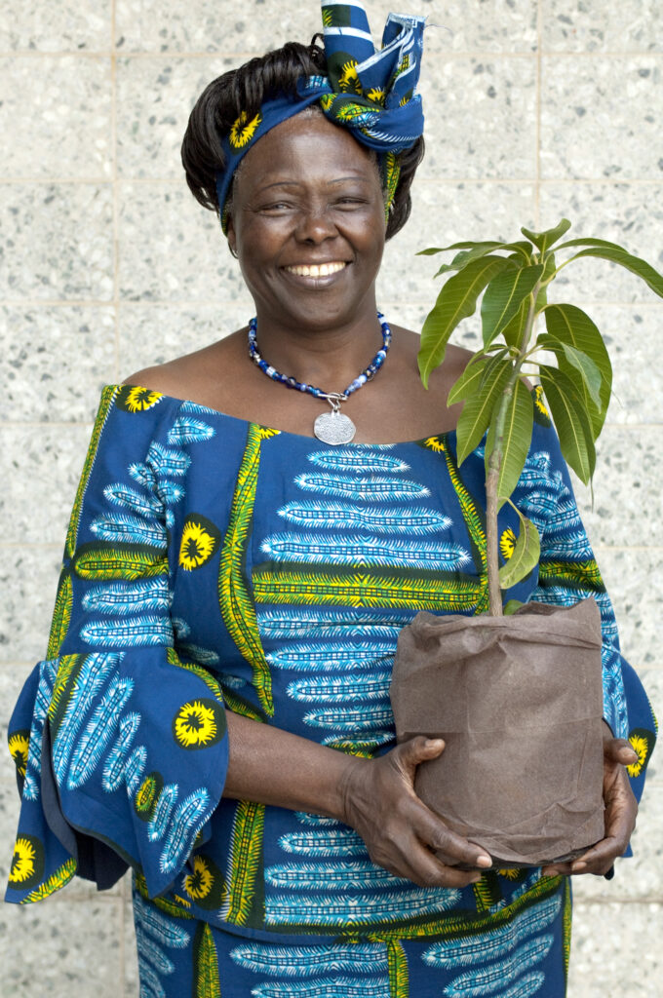
Wangari Muta Maathai
Founded the Green Belt movement, encouraging local women in Kenya to plant trees in return for a wage
2004- became the first African woman and first environmentalist to win a Nobel Peace Prize.

Slide 8
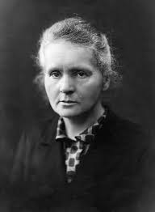
Marie Curie
First ever woman to win a Nobel prize and first person to win two Nobel prizes
Developed methods of separating radium, enabling its use as a radiation source to treat tumours.
Broke barriers for women in science and proved that women could achieve great things

Slide 9
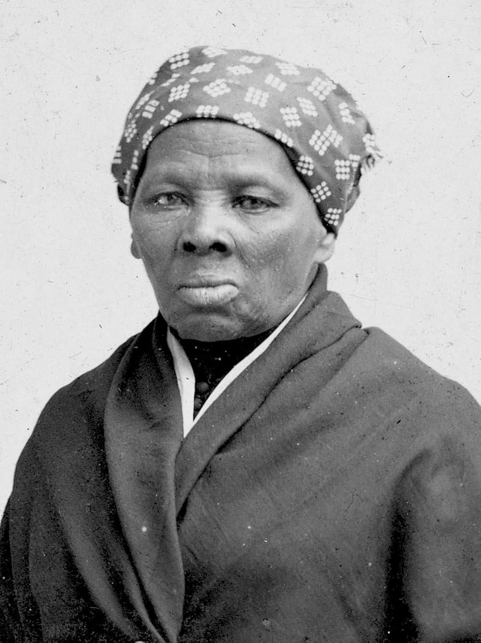
Harriet Tubman
An American abolitionist who escaped slavery and then helped many other enslaved people escape through a secret network called the Underground Railroad.
Show incredible bravery and leadership at the time when women had very few rights. Fought for freedom, justice, and equality.
Symbol of strength and courage, inspiring people to stand up for what is right!

Slide 10
Overall, Internationals Women's Day is important because it celebrates the achievements of women and recognise the progress women have made in various fields ! But also, to raise awareness about gender equality and the challenges women still face in many parts of the world.
Some websites to research more:
https://www.internationalwomensday.com
https://www.internationalwomensday.org
https://www.unwomen.org/en/get-involved/international-womens-day

