Slide 1

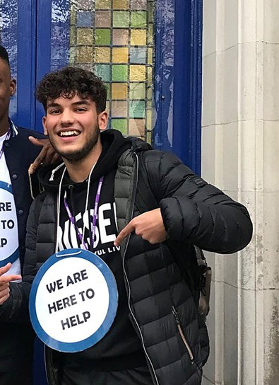
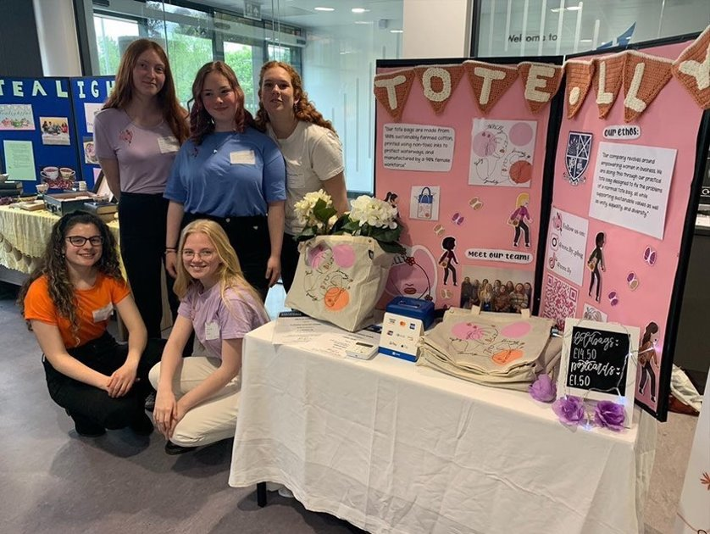
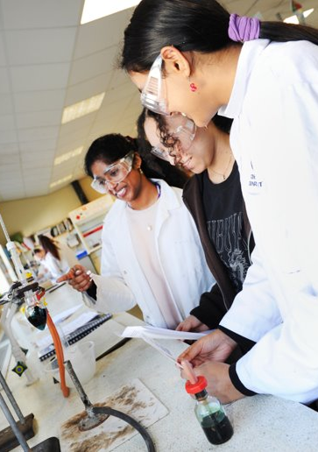
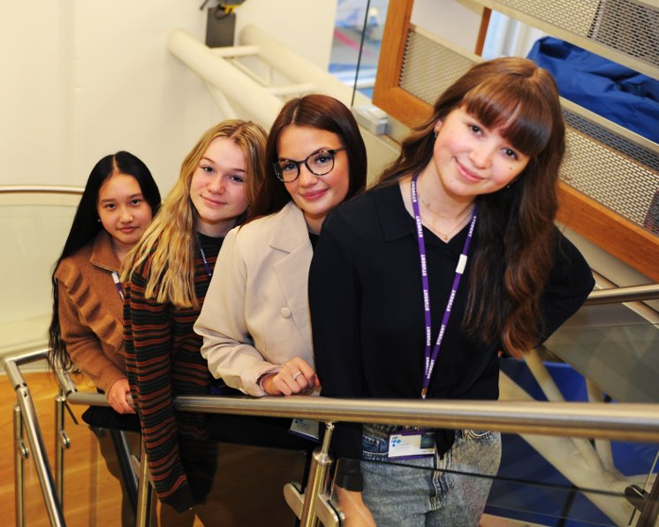
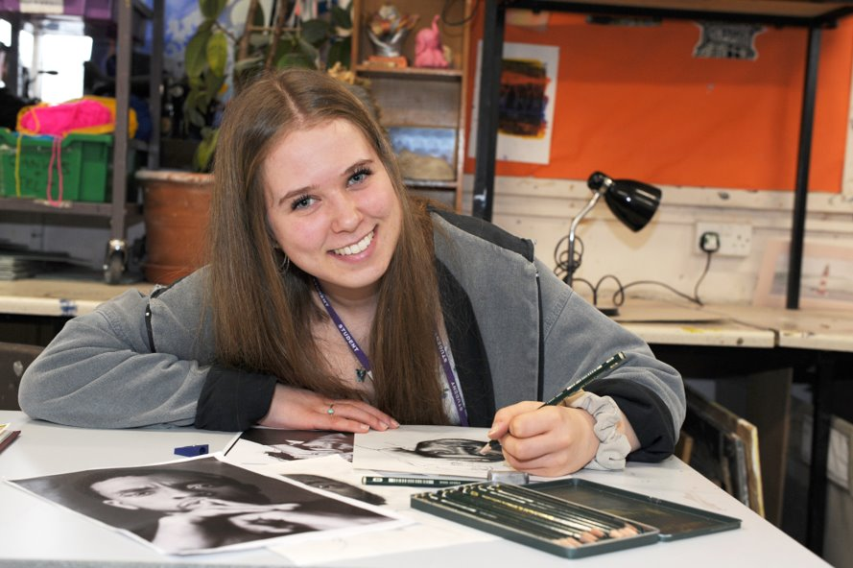
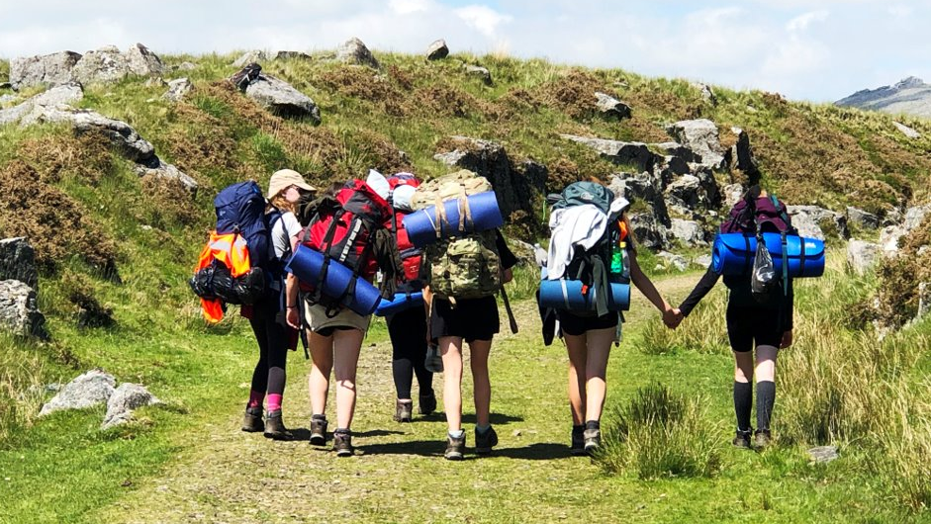
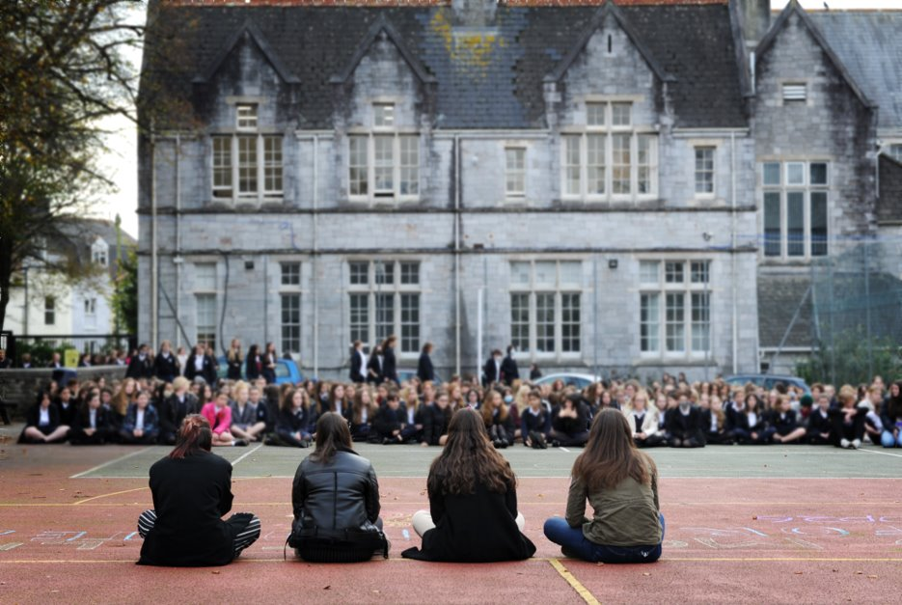
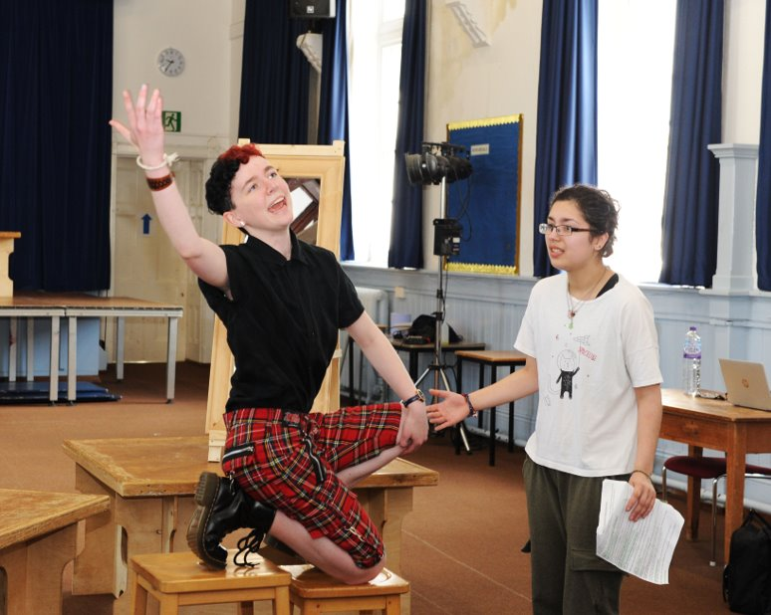
Open Evening 13th November 2025
Welcome

Slide 2
Mr Jenkins Head of Sixth Form
The WHY!

Slide 3
Preparing you for your best Post-18 Next Steps
2025 Destinations
94% going on to university now or following a gap year
46% of university places secured are at Russell Group institutions
4 accepted to study at Oxford or Cambridge
7 going on to study Medicine, Dentistry or Veterinary Medicine
8% secured high tariff apprenticeships
Notes:
Overwhelmingly, most of our students opt for uni – process is supported by Ms Findlay - some choose apprenticeships and a small number employment - encouraged to be aspirational in their choices – successes with Oxbridge and Med – but all pathways valid and personalised approach to supporting find a next step that's suitable for a successful future.
Other uni courses: 10 Law. Others include Architecture, Physics, Economics, Agriculture, Korean, Anthropology, International Relations...- showing how personalised our support is

Slide 4

Doctors, Dentists and Vets
Only school in the city with bespoke and timetabled support lessons
100% of medical applicants gain offers
100% of veterinary applicants gain offers
90% dental applicants gain offers
Destinations: 7 Medicine, 1 Vet and 1 Dentist.
1 to study dentistry abroad.
Talks at 5pm and 5.55pm

Slide 5
Completion Rate!
City Leading:
98% of students start and go on to successfully complete their A levels

Slide 6
Received Monday 10th November
Schools Liaison Officer at Regent’s Park College, University of Oxfordto share how
delighted we are t settled into l enthusiasm a
ndexcellent start to their studies
intellectual curiosity and a thoughtful, community-minded spirit.
Frankie clearly d
U m guidance and encouragement you and your colleagues have rovided, which have helped
thrive in the challenging and rewarding environment

Slide 7


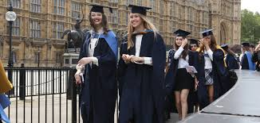

Mr Underdown - Headteacher
To cover:
The challenge of A levels
Student leadership
Notes:
Preparation for university, great environment, similar people
Best possible grades – show the university what you are capable of and that you are ready for their challenging courses
Making friends, learning together, supporting each other, pushing each other
Specialist teachers make all the difference. Good subject knowledge, good explanations and appropriate assessments help students to be their best selves

Slide 8
Current Year 13 Student – Rashaud Roberts
Start With:
Name: Subjects: Potential Next Steps
What are the specific challenges of A levels and preparing for my best next steps?
B. What aspects of the PHS Sixth Form are most significant to me?

Slide 9
Current Year 13 Student – Tabitha Weaver
Start With:
Name: Subjects: Potential Next Steps
What advice would you give students ready to embark on their A level pathway
The most valuable aspect of our Sixth Form that I have benefitted from

Slide 10
Mr Jenkins
Our offer
Opportunities
Logistics for making the most of our open evening

Slide 11
Our Offer
5 50 5
Aiming for a minimum of a C Grade – The amount of next step doors!
Attendance is key
A dedicated Sixth Form study space with a highly skilled study coordinator
Full Time occupation
Making progress from DAY 1 is crucial
A strong and consistent format to lessons
In my honest opinion – you will be surrounded by the best support network possible

Slide 12
Outstanding care and support
Ofsted
“Students that join in the Sixth Form quickly become part of the Plymouth High family. Many parents say their child is thriving at the school.” Ofsted, April 2024
● Daily pastoral contact and support
● A diverse and inclusive peer support network, well over a third of the students that join PHS Sixth Form are from external schools
● A quality Sixth Form specific study centre along with a highly effective Sixth Form study centre coordinator

Slide 13
Opportunities
Italy (Rome, Capri, Naples, Florence…a proper Italian job!)
2027 New York and Washington – pick up a letter
Prom run by our students
Plymouth, Exeter, Cardiff and Bristol University trips
Apprenticeship fair
Alumni and careers engagement events
Social events
Trust leading leadership opportunities
The chance to manage your own environment – coffee, noodles….

Slide 14
Applying
Please use the QR that is in the prospectus
All applicants will be interviewed
Taster event after the GCSE exams

Slide 15
Logistics
There will be subject talks running throughout the evening with the advertised times on the subject door
Canteen offer and a free food in the Newman hall along with Plympton Academy showcasing their KS5 Performing Arts offer
Medicine, Dentistry and Veterinary career path students – Dr Doddrell is in lab 12 talks at 5 and 5:55pm
Please ensure that you visit our Sixth Form Study Centre where Sixth Form leaders will be present to answer any questions
We have loads of friendly Sixth Form guides around the site, please ask the subject captains to guide you to your next subject

