Slide 1
Welcome to PHS Sixth Form
Presenting | Coverage
Sixth Form Tutor Sixth Form Students Mr Underdown | The importance of building positive relationship with the tutor Making the most of my time Overview and Ethos of the school, high expectations and the role and purpose of data
Dr Doddrell | Tutorials and Medical careers
Mr Jenkins | Preparing for Next Steps after A levels Expectations, study habits and our Sixth Form study centre
Q+A | Meet the tutors

Slide 2
PTFA Welcome your help and support
In you would like more information on how you can support or get involved:
pta@plymouthhighschoolforgirls.org.uk

Slide 3






Mr Underdown

Slide 4
Making the most of every learning opportunity and working hard to achieve

Slide 5
The purpose of data
T1 check-in
Subject assessments
Mock Exams
Subject assessments
Mock Exams
Subject assessments
Final Exams
(on-going)
(by Half Term)
(April/May 2026)
(on-going)
(January 2026)
(on-going)
(Summer 2026)
12
12
13
13
12
Predicted grades need to be objective – supported by data

Slide 6
Preparing for the next step after A levels (already!)

Slide 7
Preparing for the next step Ms Findlay
2025 destinations
90% going on to university now or following a gap year
42% of university places secured are at Russell Group institutions
4 accepted to study at Oxford or Cambridge
7 are going on to study Medicine, Dentistry or Veterinary Medicine
8% secured apprenticeships
Students without a goal or vision hit a ceiling and underperform by about one grade. Students who don’t know why they’re doing A levels, are usually the first to show decreased levels of effort when the going gets tough. Oakes and Griffin 2016
Notes:
Overwhelmingly, most of our students opt for uni – process is supported by Ms Findlay - some choose apprenticeships and a small number employment - encouraged to be aspirational in their choices – successes with Oxbridge and Med – but all pathways valid and personalised approach to supporting find a next step that's suitable for a successful future.
Other uni courses: 10 Law. Others include Architecture, Physics, Economics, Agriculture, Korean, Anthropology, International Relations...- showing how personalised our support is

Slide 8
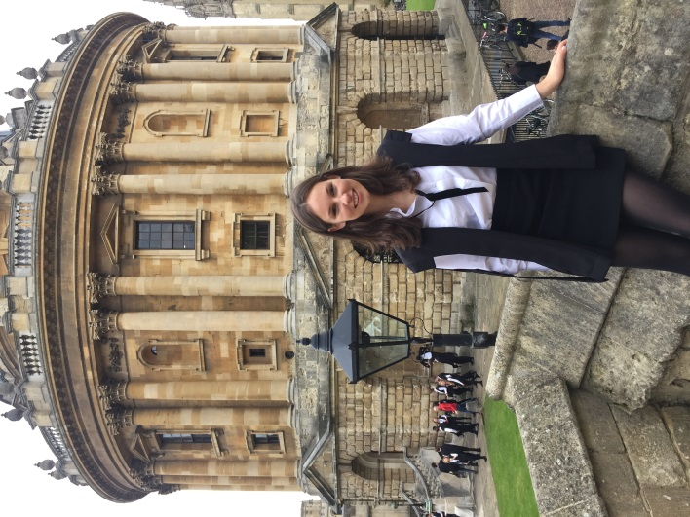
Preparing for the next step
Oxford and Cambridge
Early application date: 15th October
Workshops delivered by the Universities of Oxford and Cambridge
Free accommodation for visiting open days at Oxford
Bespoke advice about suitable super-curricular activities
Regular one-to-one meetings
Mentoring from successful alumni
Interview practice
Tailored school reference
UCAS
form
Personal statement
Predicted grades
SAQ
Reference
Offer
Portfolio
Interviews
Entrance
tests
Recent successes include:
Veterinary Medicine at Cambridge
Law at Oxford and Cambridge
Theology at Oxford
Philosophy, Politics and Economics at Oxford
Earth Sciences at Oxford
Notes:
The path for Oxbridge is different so Ms Findlay works closely with those identified as potential applicants to offer guidance e.g. interview practice.

Slide 9
Preparing for the next step
Our support includes:
Experienced tutorial team delivering programme of information
One-to-one guidance
Careers Adviser appointments
Unifrog resource platform
UCAS convention
Apprenticeship fair
Workshops at University of Plymouth
Visits form alumni and professionals
Visit to Russell Group university
Finance talk
How can you help?
Conversations about subjects and careers
View information guides on the school website
Frank discussions about finance
Visit universities together
Explore the apprenticeship route
Help with personal statement
Encourage exploration of subject through supercurricular activities:
e.g. reading, work experience, competitions, documentaries, visits, free online courses…
Notes:
Wealth of experience in dedicated team of tutors – offer a range of experiences and personalised guidance to help students decide the path for them and guide them through the application process.

Slide 10
Tutorial sessions - Dr Doddrell
Helping you to progress to a successful Sixth Form
Independent study skill sessions
Information about topics outside of the academic stream
Support for deciding on post A level options
Leadership opportunities
Compulsory – Year 12 and 13
Forms part of your student agreement with school
charlie.doddrell@phsg.tsat.uk

Slide 11
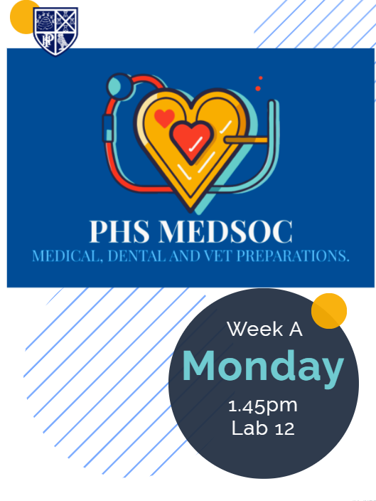
Doctors, Dentists and Vets - Dr Doddrell
Application: October 2026
Only school in the city with bespoke and timetabled support lessons
100% of medical applicants gain offers
100% of veterinary applicants gain offers
90% dental applicants gain offers
Year 13 finished: 7 Medicine, 1 Vet and 1 Dentist.
1 to study dentistry abroad.
Year 12 lesson Monday A p5 or Tuesday B p5

Slide 12
The Why!
Doing all we can to best ensure that every PHS sixth form student achieves what they require for their best post-18 next steps
A level results day 14th August 2027, 704 days away
Approximately 612 days until the first A level exam

Slide 13
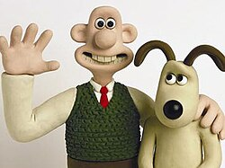
The aim for results day
Our 2025 A level results were the best our school have ever achieved for progress and raw outcomes – This is great because it allowed all of students to progress onto their best post 18 next step

Slide 14
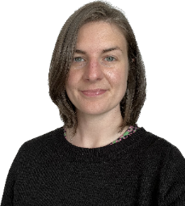
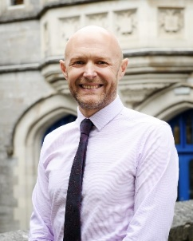
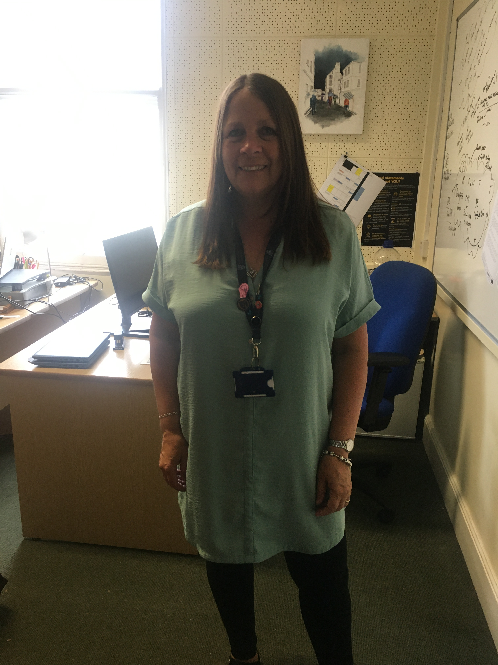
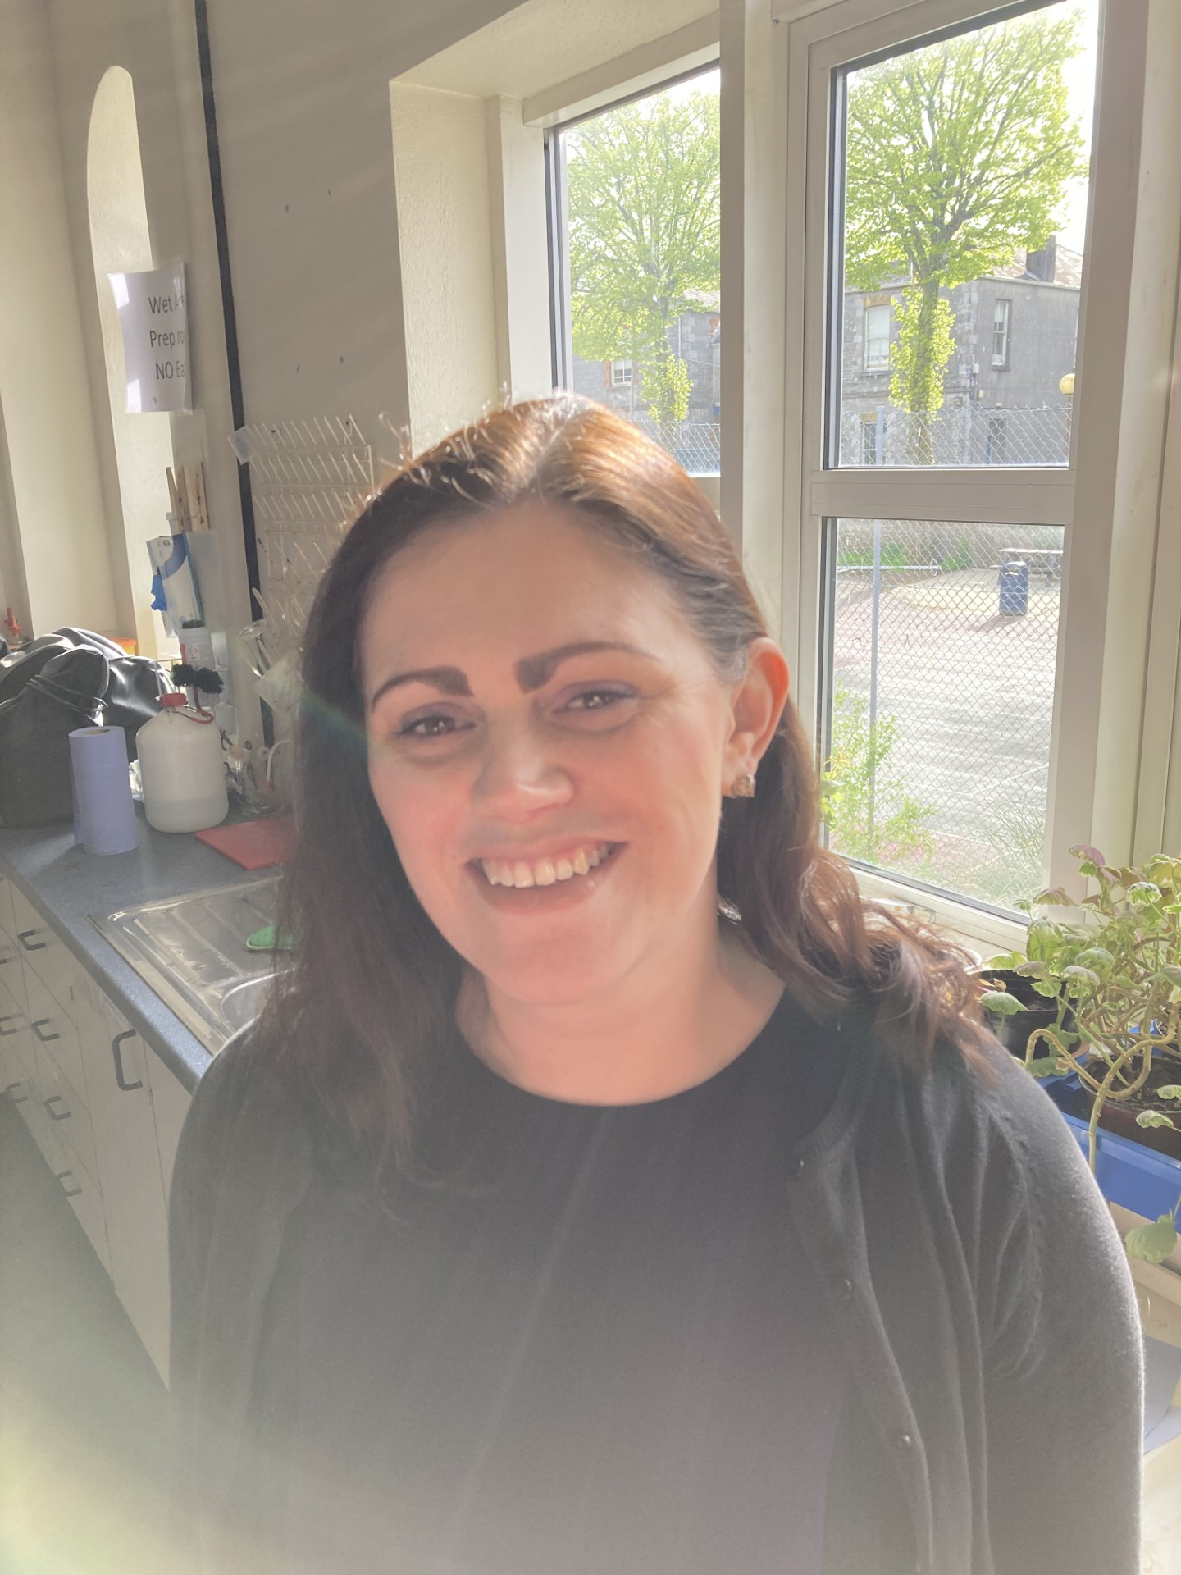
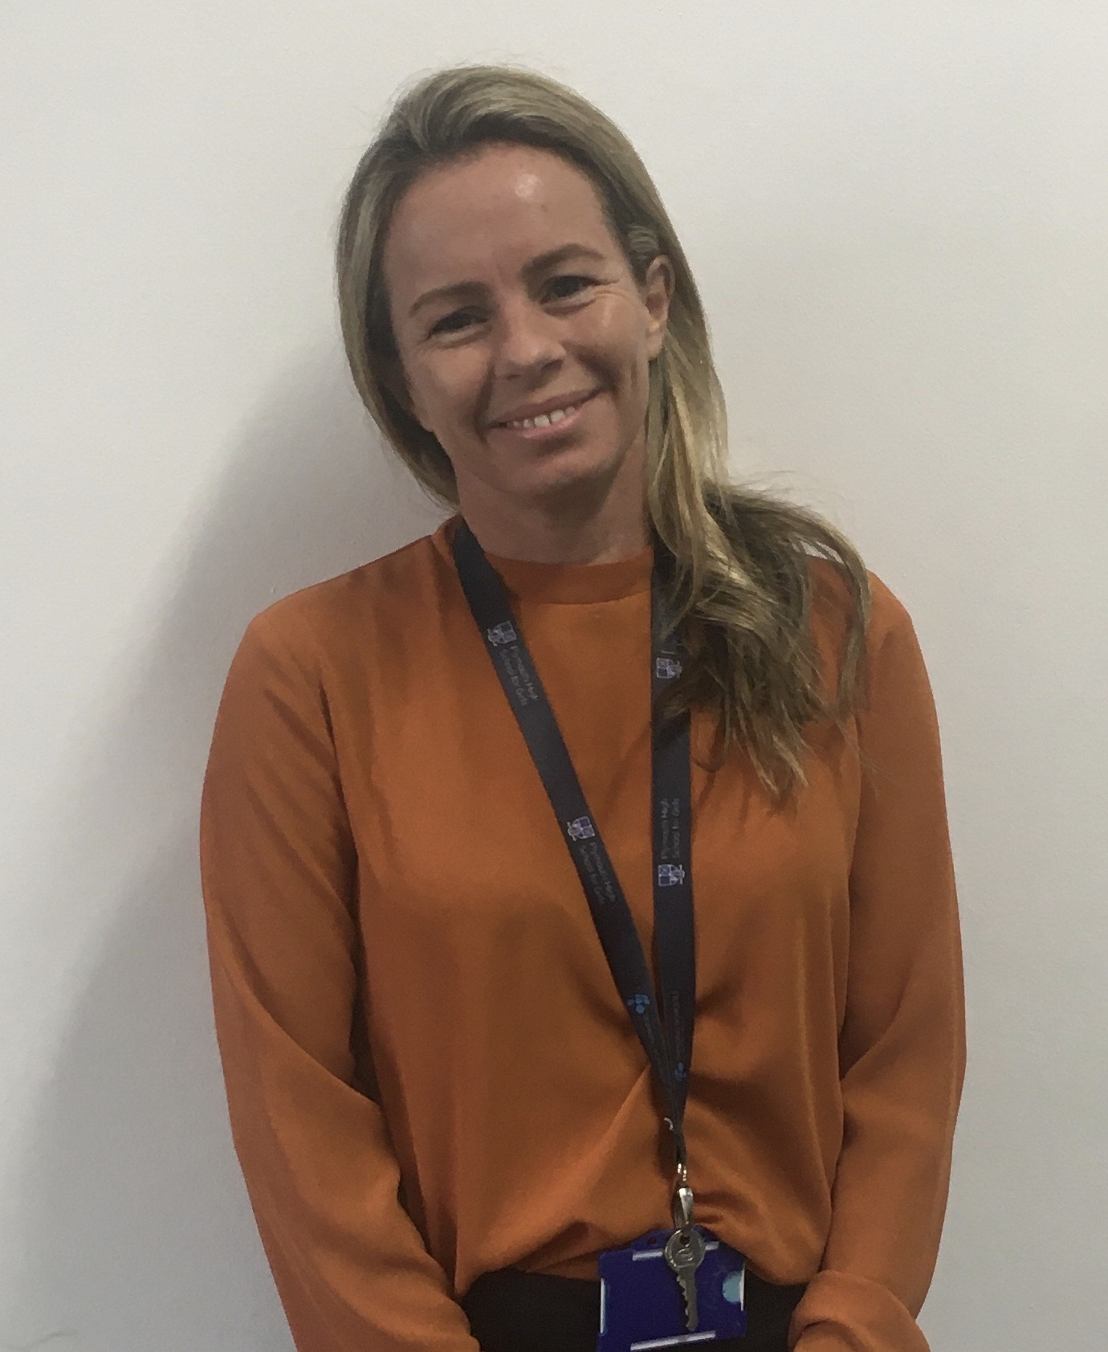
The Sixth Form team
Mr Jenkins – Head of Sixth Form
Mrs Catchpole Attendance and Sixth Form study centre co-ordinator
Mr Jenkins Head of Sixth Form
Mrs Mills Assistant to the Head of Sixth
Dr Doddrell Assistant Head of Sixth – Progress Lead KS5 and M/D/V coordinator
Ms Findlay Assistant Head of Sixth - UCAS

Slide 15
A simple expectation
That students treat their Sixth Form studies and their own Studentship as a full-time profession. It needs to be their number 1 priority if they are to successfully achieve their best next step and keep on top of their mental health.

Slide 16
Our SFSC and the 5 50 5
5 50 5 – so every student can rely upon a quiet space to complete their independent study

Slide 17
Mental health, wellbeing and being a teenager!
By keeping on top of their study within the school day they are alleviating the risk of the insurmountable from happening!
They will be making positive progress towards their required grades for their best post-18 next step
They will then have their evenings and weekends largely to do the things that they have at their age the opportunity to do
This is vitally important for their mental health, wellbeing and work life balance……for life not school we learn

Slide 18
Graduation into Year 13 and out C+ agenda
To ensure that students are ready for the challenge of A2 they will need to secure a C grade or better from their year 12 mocks
There are resits for those that achieve an D grade or lower
There will be support from teachers, our careers lead and myself to best ensure that students are ready at the end of year 12 to graduate onto year 13
We do not want any of our students' receiving results in the summer of year 13 that will not allow them to progress onto their next steps

Slide 19
What to wear?
Students must take pride and consider their appearance. They are expected to dress in a manner that is smart-casual, comfortable yet purposeful, and suitable for a school working day.
(For experiments in Science they require full length trousers)

Slide 20
Attendance Year 12
We expect students in school for all of their lessons to complete independent study up to the year 12 mocks. They should not book driving lessons or organise work shifts during the school day.
They are to sign in and out at the main reception when they want to leave during break and lunch

Slide 21
Registration activities – Leadership Opportunity
Monday
Careers and Next Steps
Tuesday
Assembly
Wednesday
A) Reading for pleasure (silent)
B) Academic reading to support study skills
Thursday
Current Affairs
Friday
House events/Quiz
If you would like to be part of the Registration Leadership Group (RLG), a chance to work with Sixth Form Team to create engaging activities to support our Sixth Form community please look out for an email this week
Everyone leads
Caroline Robinson – BBC Journalism apprenticeship

Slide 22
Plymouth High Sixth Form maximising post-18 opportunities
We all have the same goal, we are all facing the same way!

