Slide 1
Introduction
As artificial intelligence (AI) technology is rapidly evolving, it’s essential you understand how it can be used and misused within assessments.
This summary provides key points to consider, to make sure assessment is fair for all.

Slide 2

What is AI?
AI stands for artificial intelligence and using it is like having a computer that thinks
AI tools like ChatGPT or Snapchat My AI can write text, make art and create music by learning from data from the internet, but watch out – they can also make things up and be biased and ….

Slide 3
What can AI do?
What can AI do?
AI chatbots can complete tasks such as the following:
Answering questions
Analysing, improving, and summarising text
Authoring essays, articles, fiction, and non-fiction
Writing computer code
Translating text from one language to another
Generating new ideas, prompts, or suggestions for a given topic or theme
Generating text with specific attributes, such as tone, sentiment, or formality

Slide 4
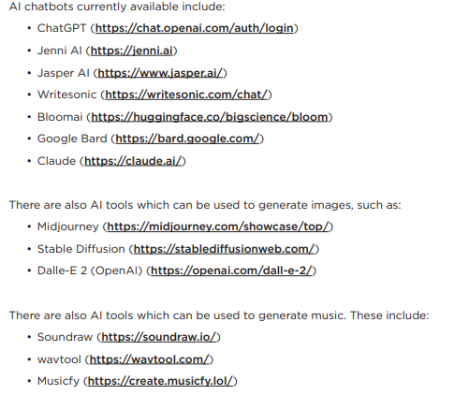
Most common AI chatbots are:

Slide 5

How can AI be misused in assessments?
THIS IS
CHEATING!
AI misuse is when you take something made using AI and say it’s your own work.

Slide 6


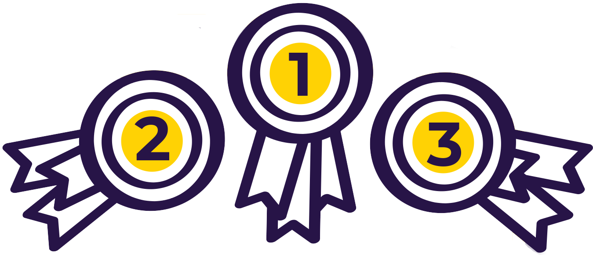

How do I make sure I don’t misuse AI?
Know the rules
Reference reference reference!
Declare it's all your own work

Slide 7
READ ALL DOCUMENTATION SENT TO YU ABOUT EXAMINATIONS AND NEA
When you get to year 11/13 all students will be emailed copies of documents relating to AI, NEA regulations and Social Media guidance
READ THEM
AND ASK IF YOU ARE NOT SURE ABOUT SOMETHING

Slide 8

Know the rules!
1
You’re not allowed to use AI tools when you’re in an examination
Your teachers will tell you if you’re allowed to use AI tools when doing your coursework – the rules will depend on your qualification
Even if you’re allowed to use AI tools, you can’t get marks for content just produced by AI – your marks come from showing your own understanding and producing your own work
1

Slide 9
:
Examples of AI misuse include, but are not limited to,
the following
Students must be able to demonstrate that the final submission is the product of their own independent work and independent thinking.
Copying or paraphrasing sections of AI-generated content so that the work submitted for assessment is no longer the student’s own
Copying or paraphrasing whole responses of AI-generated content
Using AI to complete parts of the assessment so that the work does not reflect the student’s own work, analysis, evaluation or calculations
Failing to acknowledge use of AI tools when they have been used as a source of information
Incomplete or poor acknowledgement of AI tools
Submitting work with intentionally incomplete or misleading references or bibliographies.

Slide 10
Reference reference reference!
2
If you’re allowed to use AI tools, you must reference them clearly
Name the AI tool you used
Add the date you generated the content
Explain how you used it
Save a screenshot of the questions you asked and the answers you got
2

Slide 11
Declare it’s all your own work
3
When you hand in your assessment, you have to sign a declaration
Anything without a reference must be all your own work
If you’ve used an AI tool, don’t sign the declaration until you’re sure you’ve added all the references
3

Slide 12
If your teacher suspects AI misuse…
4
IF YOU
FIND AI MISUSE
If the student hasn’t signed the
declaration form, the teacher will
follow the school
or college’s malpractice policy
If the declaration form has
already been signed, report
to the awarding body
The teacher must only accept work for assessment that they consider to be the student’s own. They will:
Compare with previous work for differences in quality, formatting, spelling, punctuation, grammar, vocabulary and tone
Look out for AI indicators, for example, language style, lack of local knowledge, confidently wrong statements
Consider the use of AI detection tools and discussing the work with the student as part of a holistic approach

Slide 13
What happens if I misuse AI?
If you’ve misused AI, you could lose your marks for the assessment.
You could even be disqualified from the subject.
You could be banned from that examination board.
They might tell other examination boards and they might also ban you
DON’T RISK IT!

Slide 14

Remember: Misusing AI is cheating!
REMEMBER
Misusing AI is cheating!
Know the rules
Talk to your teachers
Reference clearly

