Slide 1
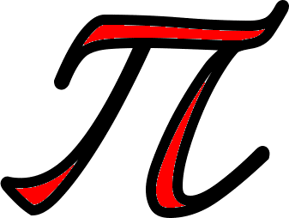
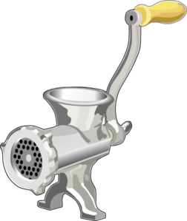

Slide 2
πR
πR
πR
πR
Notes:
Pi R Squared

Slide 4
Notes:
Octopi

Slide 5
PchickI

Slide 7
th

Slide 9
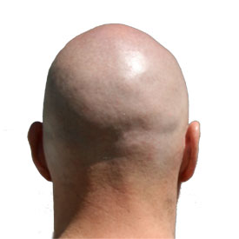

Slide 10
+
ppp

Slide 11
