Slide 1
PHSG 150th Celebration
PHSG

Slide 2
Great PHSG Bakeoff
Two students from each tutor group will represent their year group and house.
Students must be willing to bake anything and need to work together as a team.
Students need to be available for the heats and potentially the FINAL.

Slide 3
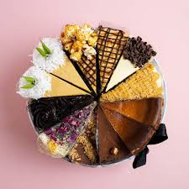
Heats
7th March – years 7 and 8
21st March – years 11 and sixth form
18th April – years 9 and 10
Heats will take place at lunchtime in room 15

Slide 4
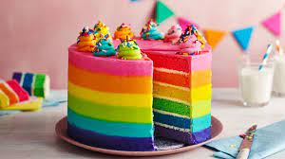
FINAL
24th APRIL
Room 15
Lunchtime and period 5

Slide 5
SCORING
Each pair will be judged on 4 elements of their bake
TASTE
Presentation
Room Management – cleanliness and hygiene
Team work

Slide 6
Tutor groups might like to organise a mini bake off in order to select who might represent them in the competition.

Slide 7
JUDGES
Mr. Underdown
Miss Roughton
Mystery Judge
Mystery Judge

Slide 8
HAPPY BAKING
Names of bakers to Mrs Banks
by the 4th March

